Slide 1
Data File Handling

Slide 2
Files
A file is a collection of related data stored in a particular area on the disk.
Programs can be designed to perform the read and write operations on these files
A program involves either or both of following kinds of data communication:
Data transfer between the console unit and the program
Data transfer between the program and a disk file

Slide 3
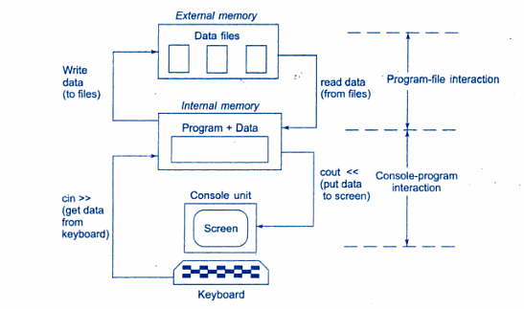
Console-program-file interaction

Slide 4
Introduction
Computer programs are associated to work with files as it helps in storing data & information permanently.
File - itself a bunch of bytes stored on some storage devices.
In C++ this is achieved through a component header file called fstream.h
The I/O library manages two aspects- as interface and for transfer of data.
The library predefine a set of operations for all file related handling through certain classes.

Slide 5
C++ provides a new technique for handling I/O operations through mechanism known as streams.
A stream refers to a flow of data.
Classified in 2 categories:
Output stream
Input stream
In output stream flow of data is from program to the output device.
In input stream the flow of data is from input device to a program in main memory.

Slide 6
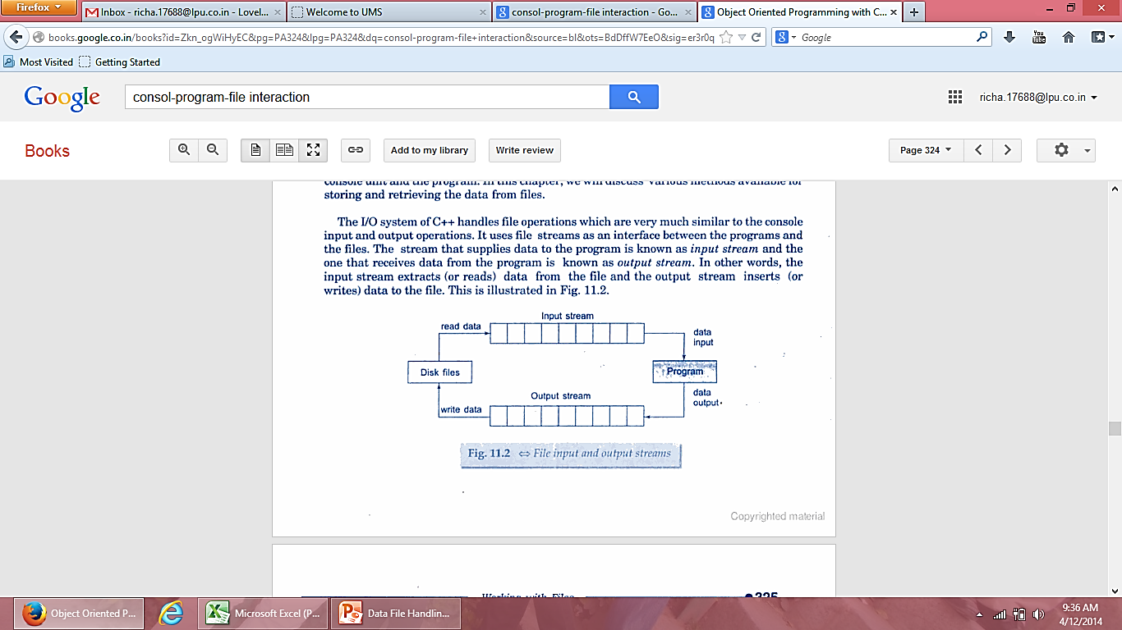
File Input and output streams

Slide 7
Classes for file stream operations
The I/O system of C++ contains a set of classes that define the file handling methods.
These include:
ifstream
ofstream
fstream
These classes are derived from fstreambase and from corresponding iostream class

Slide 8
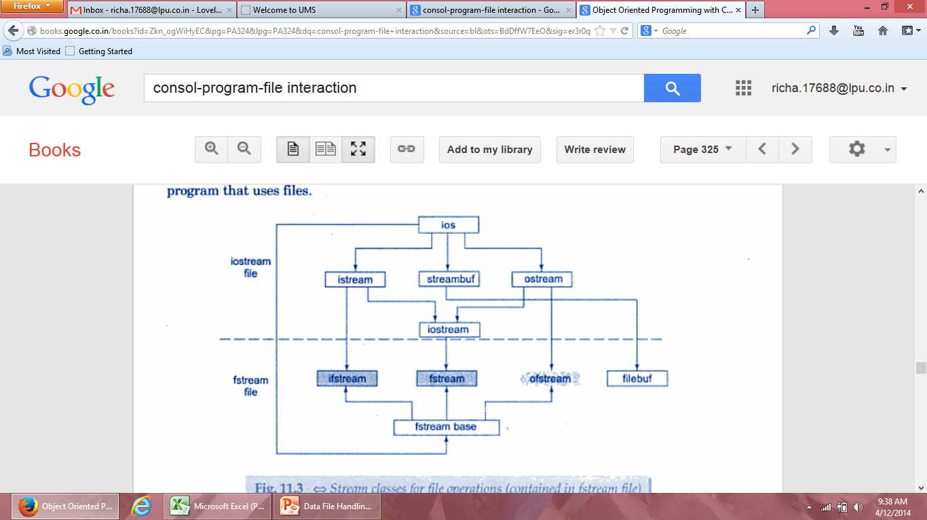
System defined streams
User defined streams
Stream classes for file operations

Slide 9
Why to use Files:
Convenient way to deal large quantities of data.
Store data permanently (until file is deleted).
Avoid typing data into program multiple times.
Share data between programs.
We need to know:
how to "connect" file to program
how to tell the program to read data
how to tell the program to write data
error checking and handling EOF

Slide 10
Opening and closing a file
If we want to use a disk file, we need to decide the following things:
Suitable name for the file
Data type and structure
Purpose
Opening Method

Slide 11
Filename
The file name is a string of characters that make up a valid filename for the operating system.
It has two parts, a primary name and an optional period with extension
Example:
Input.data
Test.doc

Slide 12
Opening a file
For opening a file, we must first create a file stream and then link it to the filename.
A file stream can be defined using the classes ifstream, ofstream and fstream that are contained in the header file fstream
A file can be opened in two ways:
Using a constructor function of the class
Using the member function open() of the class

Slide 13
Opening files using constructor
Constructor is used to initialize an object while it is being created. Here, a filename is used to initialize the file stream object.
This involves following steps:
Create a file stream object to manage the stream using appropriate class
Initialize the file object with the desired filename.

Slide 14
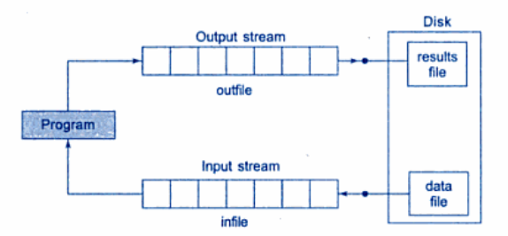
For example:
ofstream outfile(“results”); // output only
This creates outfile as an ofstream object that manages the output stream.
This statement opens the file results and attaches it to the output stream outfile

Slide 15
The following statement declares infile as an ifstream object and attaches it to the file data for reading
ifstream infile (“data”); //input only
The program may contain statements like:
outfile<<total;
outfile<<sum;
infile>>number;
infile>>string

Slide 16
We can also use same file for both reading and writing data
Program1
……..
ofstream outfile(“salary”); //creates outfile and connects “salary” to it
……...
Program2
……….
ifstream infile(“salary”); //creates infile and connects “salary” to it
………

Slide 17
Instead of using two program, one for writing data and another for reading data, we can use single program to do both operations on file.
…..
outfile.close(); //disconnect salary file from outfile
ifstream infile(“salary”); // and connect to infile
…..
…..
infile.close();

Slide 18
Write file
#include<iostream>
#include<fstream>
using namespace std;
int main()
{
ofstream of("result");
of<<"hello";
of.close();
cout<<"data saved\n";
return 0;
}

Slide 19
Read file
#include<iostream>
#include<fstream>
using namespace std;
int main()
{
char s[10];
ifstream inf("result");
inf>>s;
inf.close();
cout<<s;
return 0;
}

Slide 20
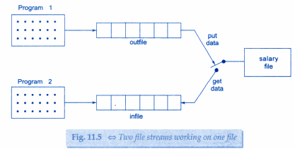
Two file streams working on same file
Program1
………………
……………….
ofstream outfile(“salary”);
……………………
…………………..
Program2
…………………
…………………..
ifstream infile(“salary”);
……………………
…………………….

Slide 21
One program read write
#include<iostream>
#include<fstream>
using namespace std;
int main()
{
char s[30];
ofstream of("result");
of<<"hello";
of.close();
cout<<"data saved\n";
ifstream inf(“result”);
inf>>s;
cout<<s;
inf.close();
return 0;
}

Slide 22
Opening files using open()
This function is used to open multiple files that uses same stream object.
Syntax:-
file_stream class stream_object;
stream_object.open(“filename”);

Slide 23
Example
ofstream outfile;
outfile.open(“Country”);
…………………..
…………………..
outfile.close();
outfile.open(“Capital”);
…………………….
…………………..
outfile.close();

Slide 24
program read write
int main()
{
const int n=80;
char s[n];
ifstream fin;
fin.open("country");
while(fin)
{
fin.getline(s,n);
cout<<s;
}
fin.close();
fin.open("capital");
while(fin)
{
fin.getline(s,n);
cout<<s;
}
fin.close();
}
int main()
{
ofstream fout;
fout.open("country");
fout<<"india\n";
fout<<"USA\n";
fout<<"UK\n";
fout.close();
fout.open("capital");
fout<<"Delhi\n";
fout<<"Washington\n";
fout<<"Londan\n";
fout.close();
}

Slide 25
Detecting end-of-file
This condition is necessary for preventing any further attempt to read data from the file.
while(fin)
here fin is ifstream object which returns a value 0 if any error occur in file including end-of-file condition.
if(fin1.eof()!=0)
{ exit(1);}
eof() is a member function of class ios. It returns non zero value if the end-of-file(eof) condition is encountered and zero otherwise.

Slide 26

File modes
General form of open() with 2 arguments is:
Prototype of member function contains default values as:
Specifies purpose for which file is opened

Slide 27
Parameter | Meaning
ios::app | Append to end-of-file
ios::ate | Go to end of file on opening
ios::binary | Binary file
ios::in | Open file for reading only
ios::nocreate | Open fail if file does not exist
ios::noreplace | Open fail if file already exist
ios::out | Open file for writing only
ios::trunc | Delete contents of file

Slide 28
ofstream fileout;
fileout.open(“hello”,ios::app);
2) void main()
{
fstream infile;
Infile.open(“data_file”, ios::in|ios::out)
----
-----
}

Slide 29
append mod
int main()
{
char s[30];
ofstream fileout;
ifstream filein;
fileout.open("data",ios::app);
fileout<<"hello world";
fileout.close();
filein.open("data",ios::in);
filein.getline(s,30);
cout<<s;
}

Slide 30
File pointers and their Manipulations
Each file has two associated pointers known as the file pointers.
Input pointer/get pointer
Output pointer/put pointer

Slide 31
Default actions
In read only mode the Input pointer is automatically set at the beginning.
In write only mode, the existing contents are deleted and output pointer is set at the beginning.
In append mode, the output pointer moves to the end of file.

Slide 32
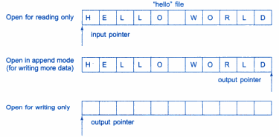
File opened in read mode:
I/p pointer automatically set at beginning.
File opened in write mode:
Existing contents deleted & O/p pointers sets at beginning.
To add more data, file is opened in append mode.

Slide 33


File pointer manipulators
These are used to move file pointer to any desired position inside file.

Slide 34
int main()
{
char s[30];
ofstream fileout;
fstream file;
fileout.open("hello",ios::out);
fileout<<"hello world";
fileout.close();
file.open("hello",ios::in|ios::out);
cout<<file.tellg();
cout<<file.tellp();
file.seekp(6);
file.seekg(6);
cout<<file.tellg();
cout<<file.tellp();
file>>s;
cout<<s;
}

Slide 35
Specifying the Offset
The arguments to seek function represents the actual position in the file.
seekp(offset, refposition);
seekp(offset, refposition);
Refposition takes one of the following three contants.
ios::beg
ios::cur
ios::end

Slide 36


Specifies position from where pointer to be moved
No. of bytes file pointer is to be moved
Takes one of 3 constants:

Slide 37
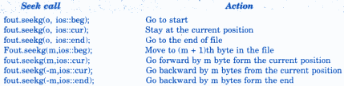
Examples

Slide 38
Specifying the Offset
The arguments to seek function represents the actual position in the file.
seekp(offset, refposition);
seekp(offset, refposition);
Refposition takes one of the following three contants.
ios::beg
ios::cur
ios::end

Slide 39
Sequential input and output operations
put(),get() used to handle single character at a time.
write(), read() functions are used to handle a stream of data.
file.put(ch);
file.get(ch);

Slide 40
#include<string.h>
using namespace std;
int main()
{
char s[80];
cout<<"enter a string";
cin>>s;
int len=strlen(s);
fstream file;
file.open("test",ios::in|ios::out);
for(int i=0;i<len;i++)
file.put(s[i]);
file.seekg(0);
char ch;
while(file)
{
file.get(ch);
cout<<ch;
}
return 0;
}

Slide 41
write() and read()
infile.read((char *)&V, sizeof(V));
outfile.write((char *)&V, sizeof(V));
These functions take two arguments, first is address of variable V, second is length of that variable in bytes.

Slide 42
int main()
{
float height[4]={17.5,15.0,3.8,5.0};
ofstream outfile;
outfile.open("abc");
outfile.write(( char *)height,sizeof(height));
outfile.close();
float p[4];
ifstream infile;
infile.open("abc");
infile.read((char*) p,32);
cout<<p[0]<<p[1];
return 0;
}

Slide 43
Reading and Writing Class object
The binary input output read() and write() are designed to write and read from disk file objects.
These functions handles entire structure of an object as a single unit .
function write() copies a class object from memory byte by byte with no conversion.

Slide 44
Example
int main()
{
student ob1,ob2;
ob1.getdata();
fstream file;
file.open("data",ios::in|ios::out);
file.write((char*)&ob1,sizeof(ob1));
file.seekg(0);
file.read((char*) &ob2,sizeof(ob2));
ob2.putdata();
}
class student
{
char name[30];
int roll_no;
float marks;
public:
void getdata()
{
cout<<"enter name";
cin>>name;
cout<<"enter rollno";
cin>>roll_no;
cout<<"enter marks";
cin>>marks;
}
void putdata()
{
cout<<name;
cout<<roll_no;
cout<<marks;
}
};

Slide 45
Updating a file
Updating means to perform following tasks:
Displaying the contents of file
Modifying the existing file
Adding a new item
Deleting an existing item.

Slide 46
These actions require the file pointers to move to a particular location.
This can be easily implemented if file contains objects of equal length.
Size of each object can be obtained using:
int ob_len= sizeof(object);
Then location of desired object from beginning is:-
int location=(m-1)*ob_len;

Slide 47
total number of objects in a file:-
int n=file_size/ob_len;

Slide 48
ERROR HANDLING FUNCTION
FUNCTION | RETURN VALUE AND MEANING
eof() | returns true (non zero) if end of file is encountered while reading; otherwise return false(zero)
fail() | return true when an input or output operation has failed
bad() | returns true if an invalid operation is attempted or any unrecoverable error has occurred.
good() | returns true if no error has occurred.

